Slide 1
Introduction to Accounting and Finance
Part 2

Slide 2
Purpose of the Regulations
True and Fair view
Requirement to produce accounting information in an approved format and timescale
Do regulations guarantee anything?
Do regulations cause their own problems?

Slide 3
Sources of Accounting Rules
International Accounting Standards Board
  International Financial Reporting Standards
  International Accounting Standards
Company law
  Disclosure of directors’ remuneration
  Disclosure of auditors’ fees
Financial Conduct Authority
  Compliance with UK Corporate Governance Code
  UK Corporate Governance Code sets out standards of good practice in relation to board leadership and effectiveness, remuneration, accountability and relations with shareholders.

Slide 4
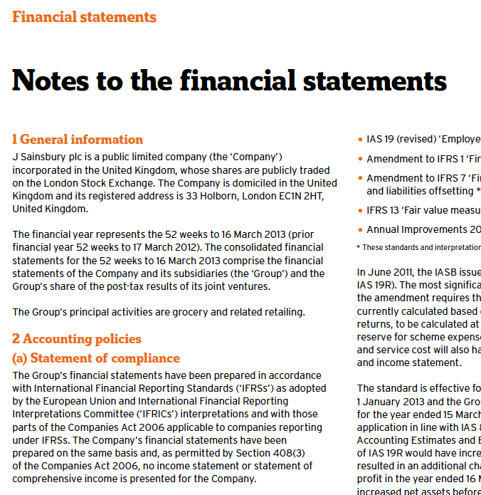
International Financial Reporting Standards
The Group’s financial statements have been prepared in accordance with International Financial Reporting Standards (‘IFRSs’) as adopted by the European Union and International Financial Reporting
Interpretations Committee (‘IFRICs’) interpretations and with those
parts of the Companies Act 2006 applicable to companies reporting
under IFRSs.

Slide 5

UK Corporate Governance Code
Sainsbury’s has again this year compiled with all provisions of the UK Corporate Governance Code

Slide 6
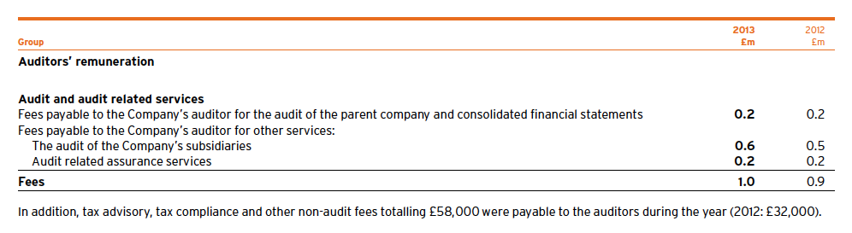
Company Law – additional disclosure
Audit fees: £1,000,000
Consultancy fees: £58,000
Independence?

Slide 7
Accounting Conventions (Concepts)
1
Business (company) entity
2
Historic cost
3
Prudence
4
Going concern
5
Dual aspect
6
Money measurement
7
Consistency
8
Accruals
9
Realisation
10
Materiality

Slide 8
Accounting Conventions (Concepts)
Business (company) entity
  Affairs of the business should be kept separately from those of the owners
  When starting a business, open a separate business bank account
Company
£20,000
Owner
(wealth £2m)
£20,000

Slide 9
Accounting Conventions (Concepts)
Business (company) entity
  Affairs of the business should be kept separately from those of the owners
  When starting a business, open a separate business bank account
Owner A
(wealth £2m)
£20,000
Company
£20,000
Owner B
(wealth £10m)
£60,000
Owner C
(wealth £100m)
£20,000

Slide 10
Accounting Conventions (Concepts)
Historic cost
  Assets and liabilities should be recorded at cost
  Not always rigidly adhered to – it can be acceptable to revalue non-current assets
  For example:
  A company bought 10 cameras from manufacturer @£300
  Sold 6 units @£500
  Now to replace the inventory, manufacturer charges @£350
  What is the value of the inventory (that is, the 4 units left)?
  £300 (historic cost) x 4 = £1,200 OR
  £350 (replacement cost) x 4 = £1,400
  Historical cost basis: (1)

Slide 11
Accounting Conventions (Concepts)
Historic cost
  Assets and liabilities should be recorded at cost
  Not always rigidly adhered to – it can be acceptable to revalue non-current assets
  Exceptions
  For example: A company bought a building worth £2.5m. Now the market value is £3m.
  What is the value of the building ?
  £2.5m (historic cost) OR
  £3m (based on revaluation)
  Either is acceptable under accounting standards

Slide 12
Accounting Conventions (Concepts)
Prudence
Accounts should present least favourable view
    Exercise caution when making accounting judgements
    But being overly prudent could lead to poor decisions being made
    Lower of cost and net realisable value
  For example,
  A company buys & sells cameras, has 5 units @£300
  Scenario A:
  Can sell for @£500
  Value of inventory = £1,500 (5x£300) OR £2,500 (5x£500)
  use £1,500 (historic cost)
  Scenario B:
  Cameras become obsolete, can only sell for @£250
  Value of inventory = £1,500 (5x£300) OR £1,250 (5x£250)
  use £1,250 (net realisable value)

Slide 13
Accounting Conventions (Concepts)
Going concern
  Assumption that business will continue for the foreseeable future (usually 12 months)
  If business is not considered a going-concern, accounting rules would have to be changed
  E.g. writing down of assets, such as inventories
  For example,
  A company buys & sells cameras, has 5 units @£300
  It cannot meet the debt payments and has to liquidate
  Quick sale of cameras: £200
  What is the value of the inventory?
  Historic cost = £1,500
  But going concern problem, therefore
  = £200 (net realisable value) x 5
  = £1,000

Slide 14
Accounting Conventions (Concepts)
Dual aspect
Every transaction will affect two accounts
  A businessman starts a business by paying in £5,000 capital.
  Cash (ASSET) ↑£5,000 Share capital (EQUITY) ↑£5,000
  The business pays £800 cash to purchase a stock of goods for resale
  Cash (ASSET) ↓£800 Inventory (ASSET) ↑£800
  An investor lends the business £2,000
  Cash (ASSET) ↑£2,000 Loan (LIABILITIES) ↑£2,000

Slide 15
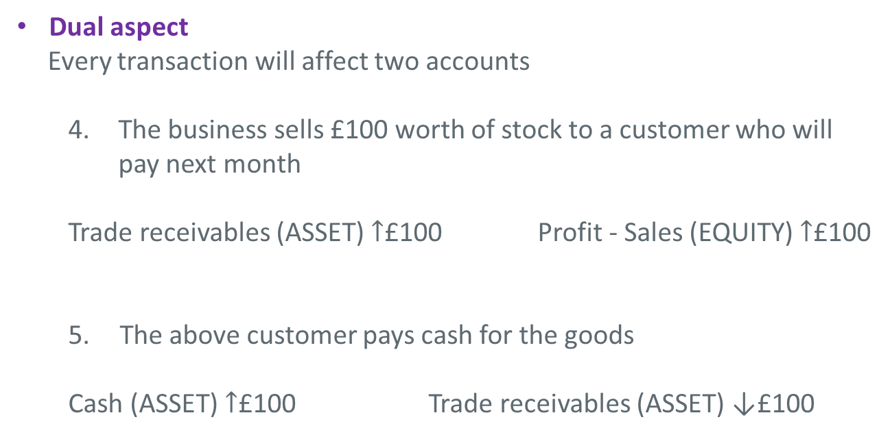
Accounting Conventions (Concepts)
Dual aspect
Every transaction will affect two accounts
  4. The business sells £100 worth of stock to a customer who will pay next month
  Trade receivables (ASSET) $↑$£100 Profit - Sales (EQUITY) $↑$£100
  The above customer pays cash for the goods
  Cash (ASSET) $↑$£100 Trade receivables (ASSET) ↓£100

Slide 16
Accounting Conventions (Concepts)
Money measurement
Accounts are restricted to matters which can be measured in money terms
  Cannot place a money value on things such as ‘employee loyalty’ so cannot include in accounts
Consistency
Figures should be comparable from one year to the next
  Accounting policies should not change from one year to the next, unless there is a good reason

Slide 17
Accounting Conventions (Concepts)
Accruals
Costs are accounted for as they are incurred, regardless of when money is paid
  electricity used this year should be included in the accounts for this year, even if the last bill will not be paid until next year
  rent paid in advance should be removed from this year’s accounts, as it is an expense related to next year
Realisation
Income is recognised as and when it is earned, not when payment is received
  A sale is recorded when made, whether or not the customer pays cash or pays later

Slide 18
Accounting Conventions (Concepts)
Materiality
Adjustments are only made to ‘material’
  Significant?
  Would the adjustment affect true and fair view?
  Would the adjustment affect an opinion?
  Large or significant items are adjusted

Slide 19
Summary
Accounting is concerned with collecting, analysing and communicating information.
Accounting information may be used to make internal decisions or provide external information
Regulations and rules surround the way accounting information is presented
Fundamental concepts underpin accounting information
Stakeholders may be interested in the accounts

